Slide 1
Welcome to Utopia
COP4331 Small Project - Team 3

Slide 2

01
The Utopia Team
Alan Phan Project Manager
Rodrigo Costa API
Jacob Mckiernan API
Jonathan Alonso Database/API
Jason Helman Front-end
Joseph Simon Front-end

Slide 3
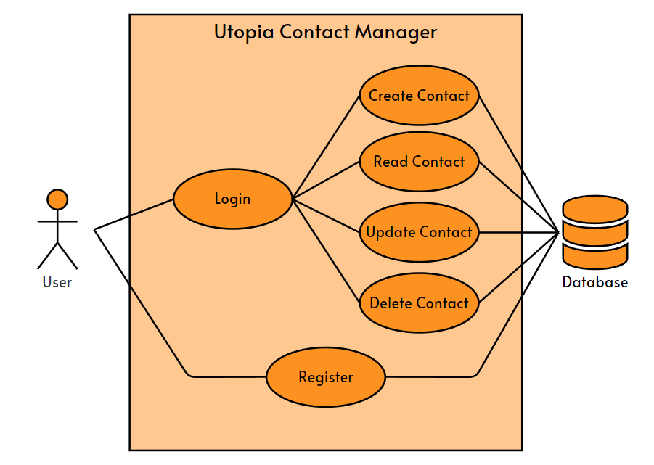
02 Use Case Diagram

Slide 4
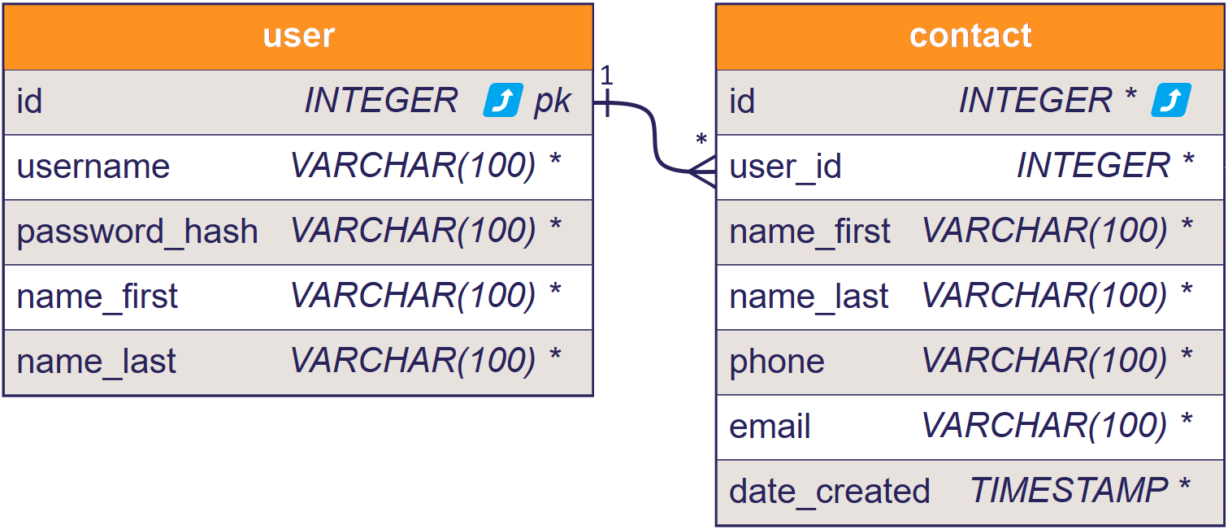
03 Entity-Relationship Diagram

Slide 5
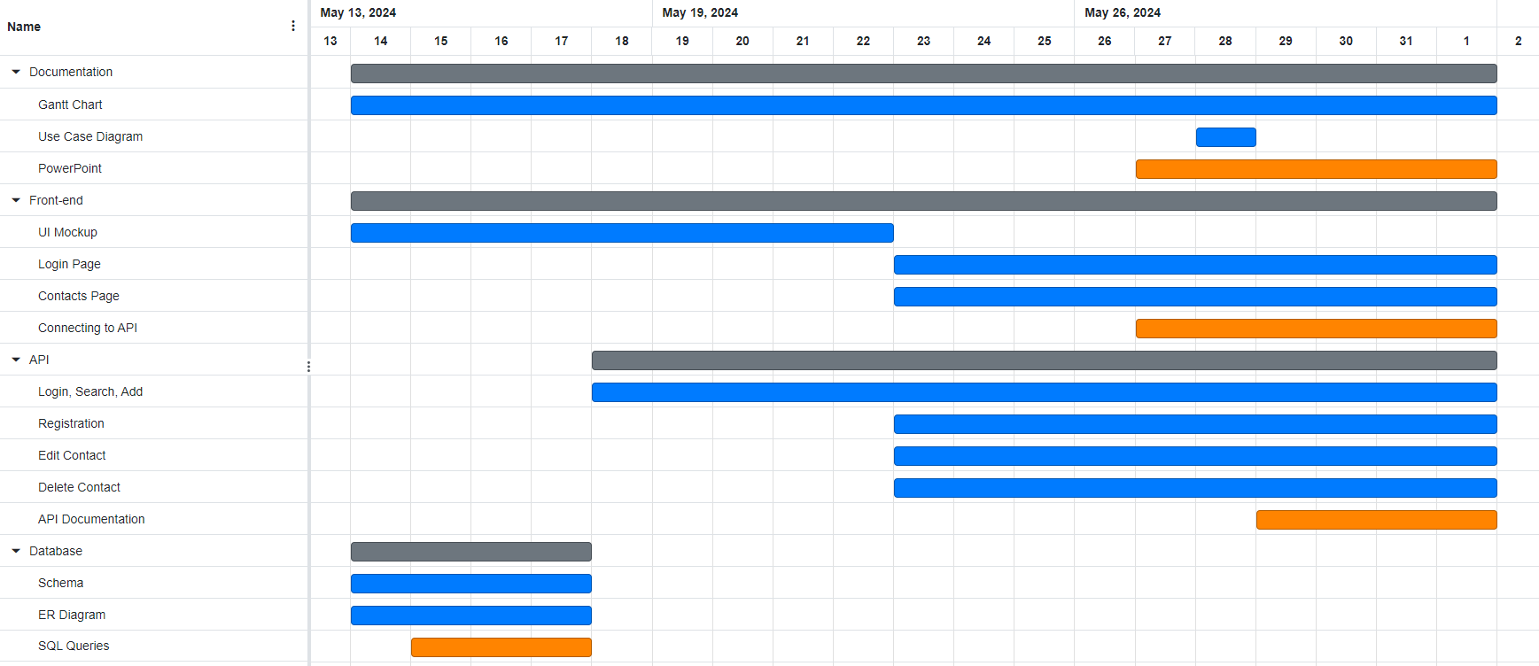
04 Gantt Chart

Slide 6












05 Technology Used
Project Management
Database
Discord, Zoom
GitHub
Visual Paradigm, Online GANTT
MySQL
sql2dbml
dbml-renderer
Front-End
API
VSCode
HTML, CSS, JavaScript
TypeScript
jQuery
VSCode
PHP
MobaXterm, FileZilla
Postman, SwaggerHub

Slide 7
06a
Management Thoughts
What did go well?
What didn’t go well?
Active and daily communication
Clearly defined expected timeline
Lots of back-and-forths that lead to inefficient development

Slide 8
06b
Database Thoughts
What did go well?
What didn’t go well?
Initial development was quick:
Schema
Database production
Generating ER diagrams
Limited by pricing

Slide 9
06c
API Thoughts
What did go well?
What didn’t go well?
Endpoints worked during testing
Having sample PHP files from the Colors Lab
Little experience in PHP
Documentation was difficult
Typos and inconsistencies
Error handling was not well-implemented

Slide 10
06d
Front-End Thoughts
What did go well?
What didn’t go well?
Using TypeScript during development
Typos, object types, properties
Difficulties with CSS
Delays with API caused issues during front-end development

Slide 11
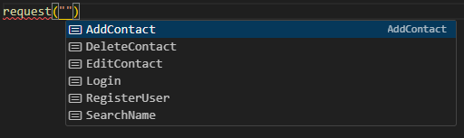
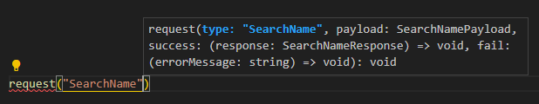
07
TypeScript

Slide 12

08 Color Palette
Inspired by primary image

Slide 13
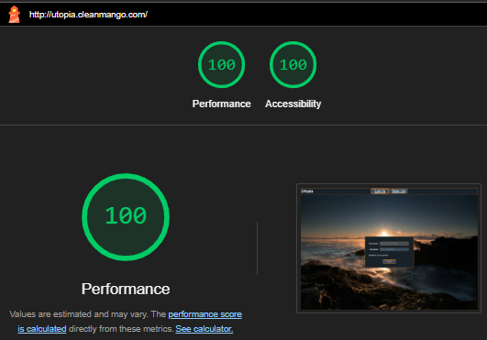
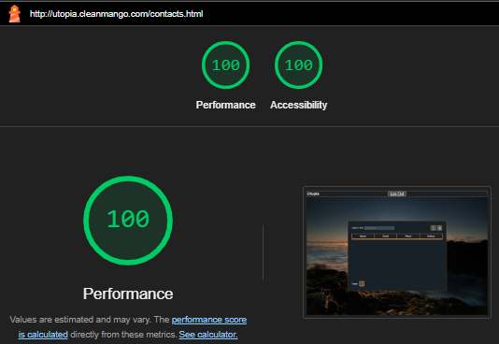
09 Google Lighthouse
Log In/Sign Up Page
Contacts Page

Slide 14




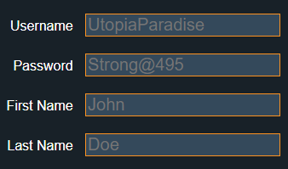
10
Accessibility
Accent color for boundaries
Underlining and color for clear intent
Crossing out unclickable buttons
Consistent sizing of elements to make information clear
Labels outside input fields

Slide 15
11 API Demonstration
SwaggerHub

Slide 16
12 Application Demonstration
http://utopia.cleanmango.com/

Slide 17

13 Attributions
Primary website image by Zac Durant (Link)
Website icons by Pictogrammers (Link)
Original presentation template by Slidesgo (Link)

Slide 18
Questions?

